Slide 1
Experiences with OVN on Kelda
Ethan J. Jackson
Kelda

Slide 2
About Me
Open vSwitch Committer
UC Berkeley PhD Student
Advised by Scott Shenker
Founder, CEO of Kelda
kelda.io
Notes:
Advised by Scott Shenker
Brand new tiny startup started out of research I did at UCB

Slide 3
Kelda
Notes:
Going to spend some time motivating Kelda
Then will go into how it uses OVN

Slide 4
Rise of Complex Distributed Systems
Spark
Hadoop
Elastic Search
Logstash
Kibana
Redis
Etcd, Zookeeper, Consul
…
Notes:
Cloud caused rise of ...
Modern apps cobble these things

Slide 5

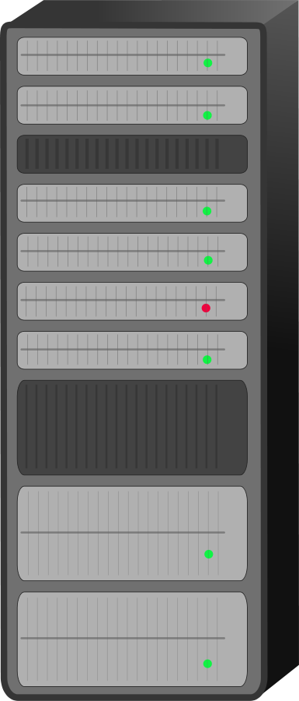
Ideal
cloud.deploy()
Spark
…
HDFS
Elastic Search
Notes:
How to I get these things running in the cloud?
What you really want, attached to these projects is a simple deploy button

Slide 6
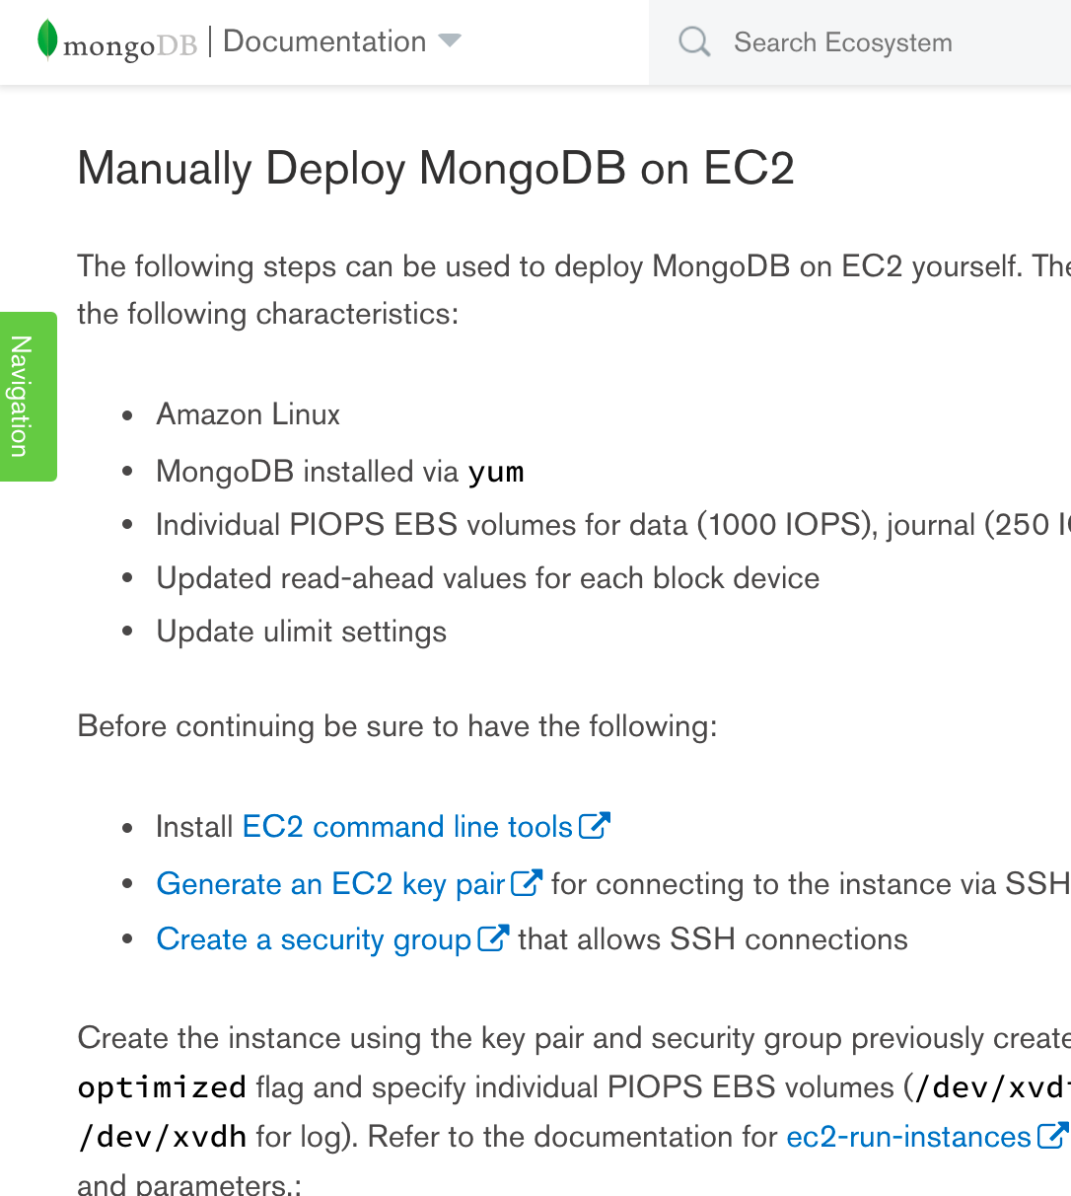
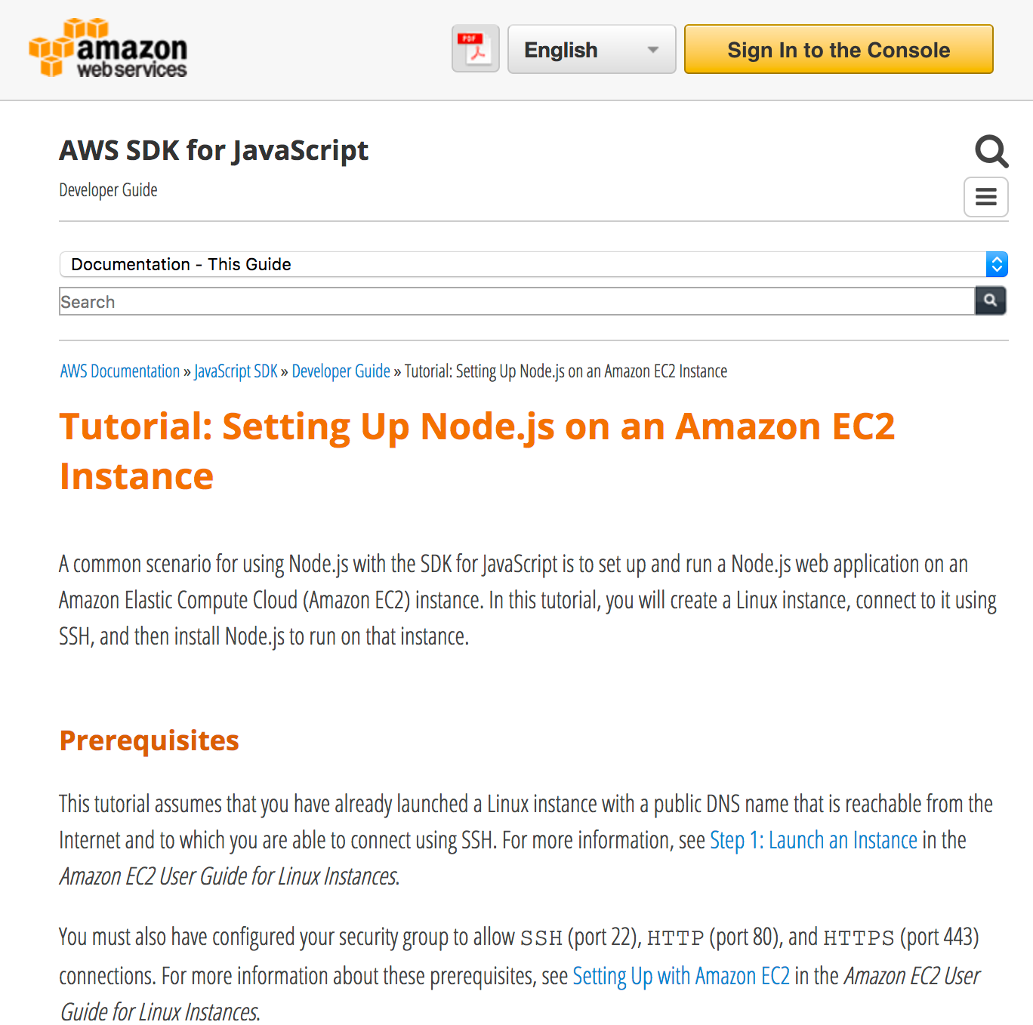
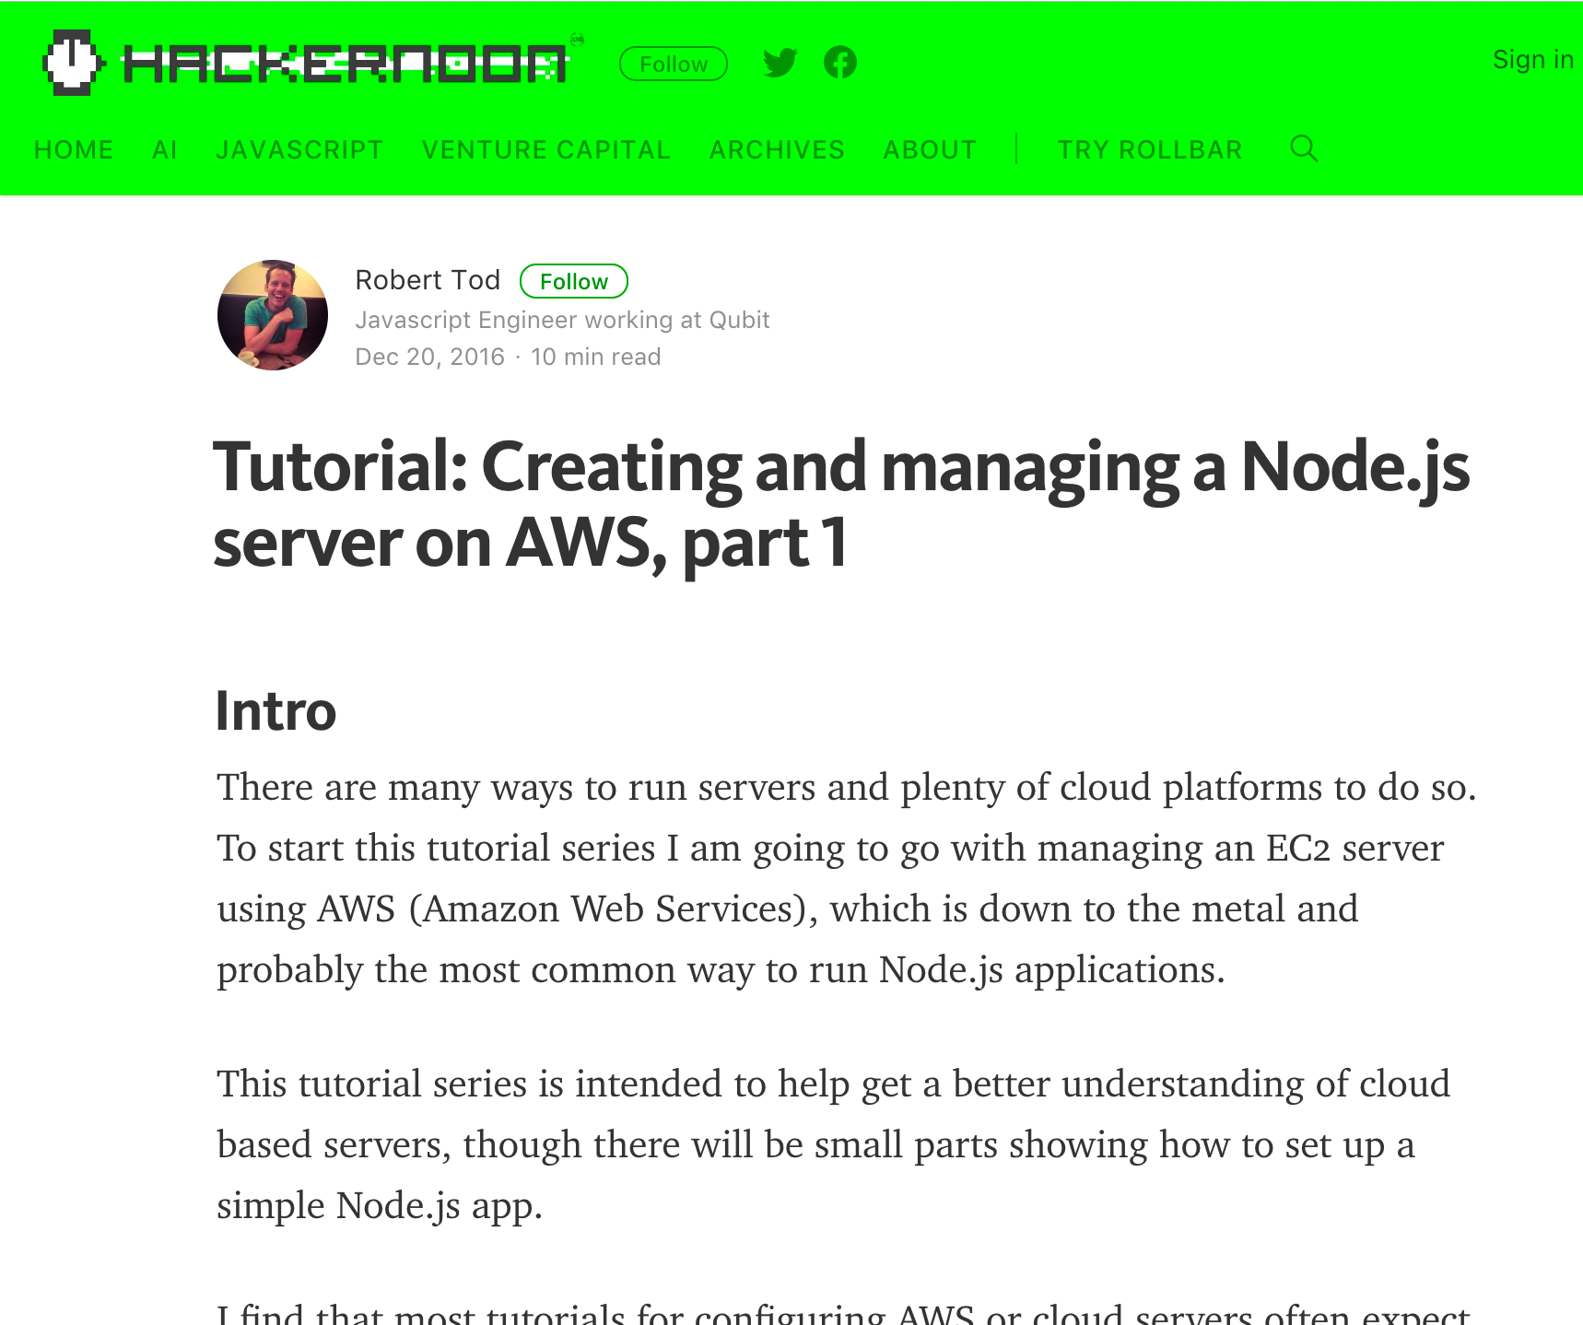
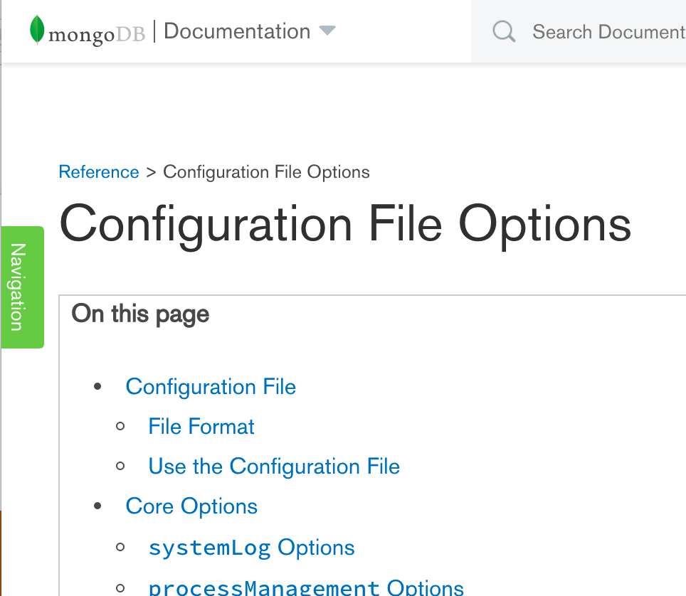
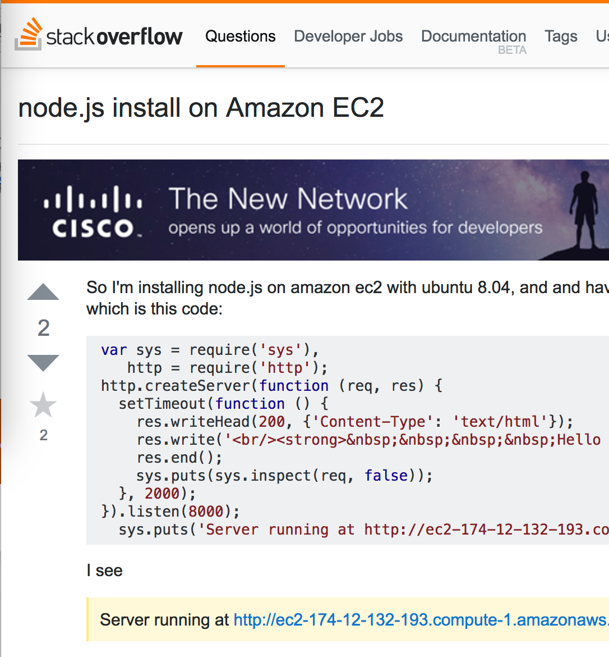

Spark
…
HDFS
Elastic Search
Spark
Spark
…
HDFS
Elastic Search
HDFS
Elastic Search
Spark
…
HDFS
Elastic Search
Notes:
Read some documentation, try, not quite right
Read some more tutorials, understand more about config, and get closer, but still not quite right
Look for help: send an email on mailing list, ask on company slack, sit down for help with a c-worker IF YOURE LUCKY it’s right.

Slide 7
Running in the cloud requires expertise
Acquiring expertise is hard
Spark
…
HDFS
Elastic Search
Spark
Spark
…
HDFS
Elastic Search
HDFS
Elastic Search
Spark
…
HDFS
Elastic Search
Notes:
Read some documentation, try, not quite right
Read some more tutorials, understand more about config, and get closer, but still not quite right
Look for help: send an email on mailing list, ask on company slack, sit down for help with a c-worker IF YOURE LUCKY it’s right.

Slide 8
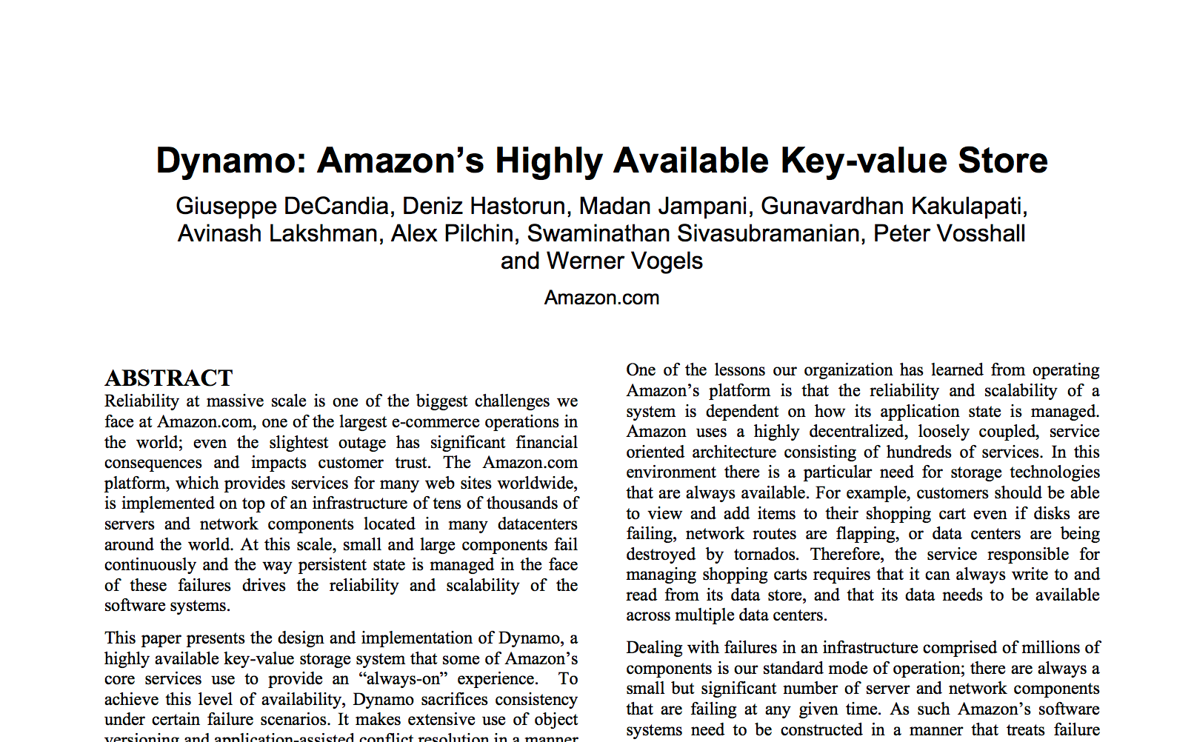
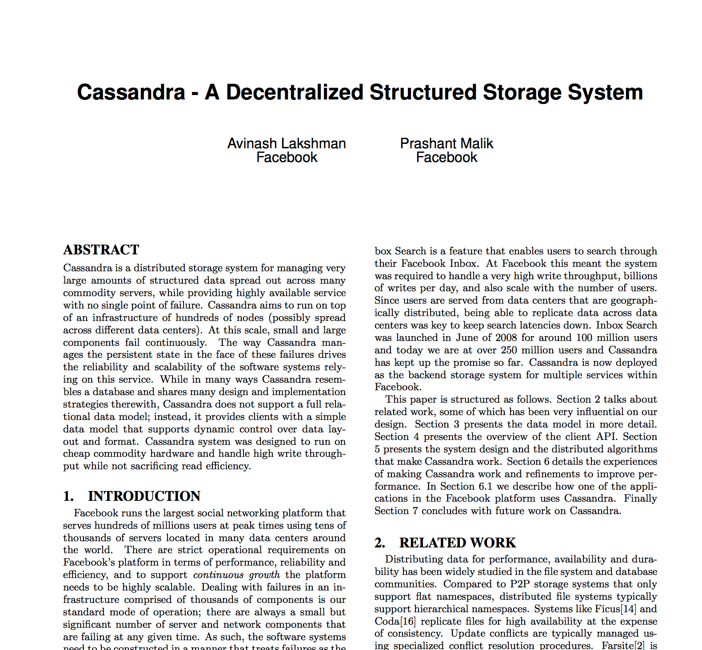
“I want persistent storage”
Spark
Mongo
$ git clone github.com/mongodb/mongo.git
Acquiring code is easy
Notes:
There’s code that describes how to do this!
Do git clone instead!!! More correct. We have key value stores you can get code for.

Slide 9
Distributed systems require expertise to operate
Acquiring expertise is hard
Acquiring code is easy
Kelda:
Package expertise in code
Notes:
Question: why can’t we do this all using code?
Quilt: turn expertise into code

Slide 10
Encode expertise in JavaScript
$ npm install kelda/spark
const spark = require(‘@kelda/spark’);
let sparkCluster = new spark.Spark(64);
Notes:
Here, say “in Boris’s node.js code…”
"He can import the expertise required to run Spark" /
install the expertise required to run Sparkon his local system.
Then he can integrate this expertise with his broader application

Slide 11
Kelda
JavaScript Blueprint Library
Everything necessary to operate an application
Code, Network, Configuration, etc.
Deployment Engine
Consumes Blueprints
Deploys them to the cloud
new spark.Spark(64);
kelda run sparkRun.js
Notes:
Blueprint Library: Important, not going to talk about it
Deployment Engine: Uses OVN, going to talk about this

Slide 12
Kelda Deployment Engine

Slide 13
Deployment Engine
Simple deployment of blueprints anywhere
Amazon, Google, Digital Ocean
Soon: Azure, Kubernetes, Mesos, OpenStack, VMware, …
Portability
Easily change cloud providers
Key design goal of the system
new Machine({
provider: ‘Amazon’,
cpus: 2,
ram: 16, })
google

Slide 14
Portability
Platforms have wildly different APIs and abstractions
Supporting everything, everywhere, consistently, is not tractable
… except for x86
Ubuntu VMs are basically the same everywhere
OVN provides consistent network experience

Slide 15
Architecture
Kelda Controller
OVN Northd
Etcd
Master
Master
Worker
Worker
Worker
Application Containers
Open vSwitch
STT Overlay
Notes:
Kelda sets up VMs in a cloud providers
Configures some as masters, some as workers
Install a controller, and OVN on the masters
OVS and application containers on the workers

Slide 16
OVN Virtual Network Architecture
Load Balancer
LLogical Switch
Container
Container
Container
Container
Notes:
Pretty Simple
Giant Layer 2 Switch
ACLs on each port
Micro-segmentation
Don’t use
IPAM
Gateways
Localnet

Slide 17
Kelda OVN Customizations
OVS Docker containers
docker pull keldaio/ovs
STT
kelda-int bridge
Intercepts packets before OVN
Container
kelda-int
br-int

Slide 18
General Impressions of OVN
Good things

Slide 19
Extremely Stable
By far the most stable part of the project
We’ve had more Linux Kernel panics than OVN crashes …
Even back in the early releases …

Slide 20
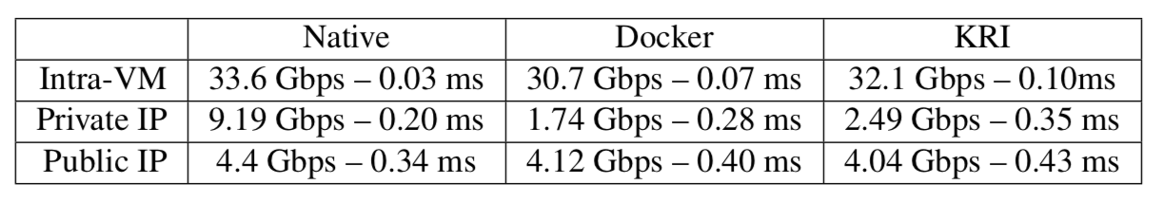
Performance
Kelda
Notes:
C4.8xlarge VM amazon
Native is the VM’s network performance
Docker is standard Docker
Kelda
Intra VM – two containers on the same machine
Private IP two containers on a different VM
Out-performs docker

Slide 21
Roadmap
Features we need magically appear …
Address Sets
IPAM
DNS
Localnet
Notes:
* Haven’t had a chance to take advantage of a lot of these yet …

Slide 22
General Impressions of OVN
Opportunities for improvement

Slide 23
ACL Scaling
Kelda does micro-segmentation
ACLS tend to grow at O(N^2)
Before address sets this was catastrophic
OpenFlow rules still a problem

Slide 24
OVSDB API Language Support
OVSDB has a great C API
Hard to interact with from go
Go is the de-facto standard for container infrastructure
Docker, Kubernetes, Etcd, …
A GRPC front-end would go a long way …

Slide 25
Marketing
Networking for containers is crowded
Calico, Contiv, Contrail, Flannel, Cilium, Weave, Envoy, Istio …
OVN compares favorably with these systems
... yet is not as well known in this community
Small improvements could help a lot
Dedicated OVN Website
Getting Started Guide
Tutorials

Slide 26
Wrapping up
Kelda encodes operational expertise in JavaScript
Deploys that expertise portably across cloud providers
Makes heavy use of OVN to achieve this
Try it out at kelda.io
Simple way to play around with OVN

Slide 27
Thanks
kelda.io

